Slide 1

Differentiable programming for modeling and control of energy systems
AI for Energy Innovation Workshop 37th
AAAI Conference on A​rtificial Intelligence 2023
Ján Drgoňa Collaborators: Aaron Tuor, James Koch, Shrirang Abhyankar, Ethan King, Zhao Chen, Draguna Vrabie

Slide 2






Differentiable Programming
Differentiable Programming
M. Innes, et al., A Differentiable Programming System to Bridge Machine Learning and Scientific Computing, 2019
Physics-informed Neural Networks
M. Raissi, et al., Physics-informed neural networks: A deep learning framework for solving forward and inverse problems involving nonlinear partial differential equations, 2019
Neural Differential Equations
R. T. Q. Chen, et al., Neural Ordinary Differential Equations, 2019
C. Rackauckas , et al., Universal Differential Equations for Scientific Machine Learning, 2021
Differentiable Optimization
A. Agrawal, et al., Differentiable Convex Optimization Layers, 2019
P. Donti, et al., DC3: A learning method for optimization with hard constraints, 2021
S. Gould, et al., Deep Declarative Networks: A New Hope, 2020
J. Kotary, et al., End-to-End Constrained Optimization Learning: A Survey, 2021
Differentiable Control
B. Amos, et al., Differentiable MPC for End-to-end Planning and Control, 2019
S. East, et al., Infinite-Horizon Differentiable Model Predictive Control, 2020

Slide 3
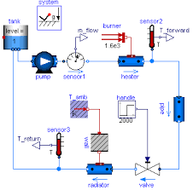
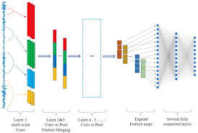
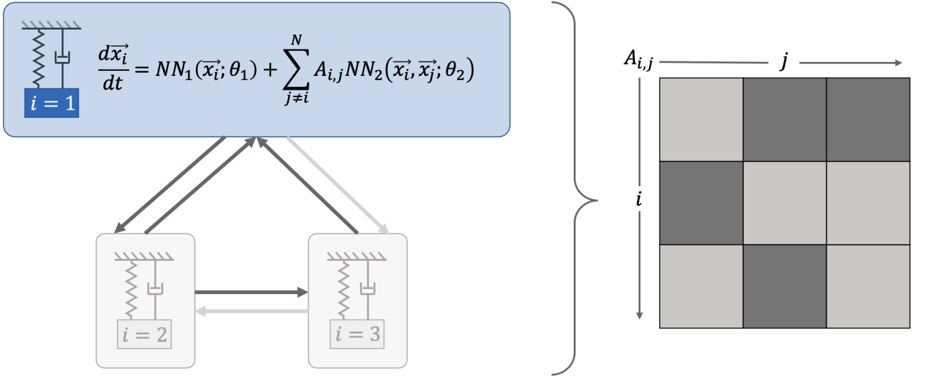

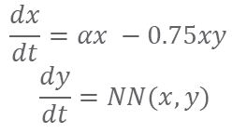
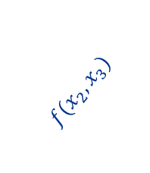
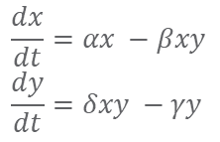
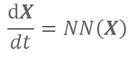
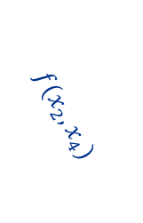
Data-driven Modeling of Dynamical Systems
White-box
Gray-box
Black Box
$$\frac{dx}{dt}=αx −βxy$$
$$\frac{dy}{dt}=δxy −γy$$
$$\frac{dx}{dt}=αx −0.75xy$$
$$\frac{dy}{dt}=NN(x,y)$$
Models
$$\frac{dX}{dt}=NN\left(X\right)$$
More domain knowledge
Less domain knowledge
physics-based
networked neural ODEs
black box neural ODEs
state space models
physics priors
graph neural networks
3
$$f(x_{2},x_{3})$$
$$f(x_{2},x_{1})$$
1
2
$$f(x_{2},x_{4})$$
4

Slide 4
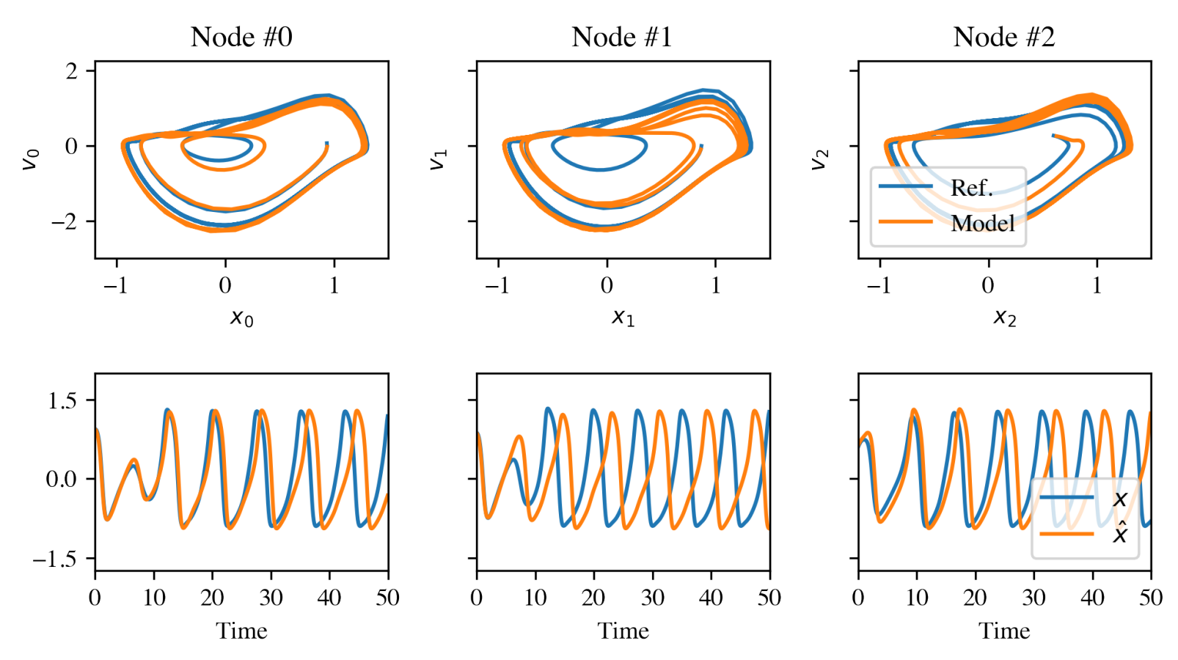
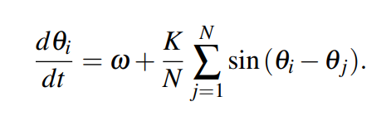
Networked Dynamical Systems via Universal Differential Equations
Network of unknown oscillators
Coupling adjacency
Qualitative out of distribution generalization of learned dynamics on never-seen network topology.
Ground truth Kuramoto system:
J. Koch, Z. Chen, A. Tuor, J. Drgona, and D. Vrabie, Structural inference of networked dynamical systems with universal differential equations, Chaos 33, 023103, 2023.

Slide 5
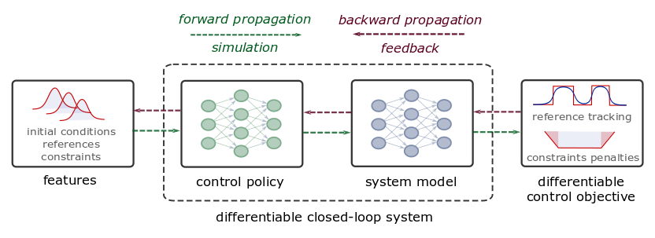
Differentiable Predictive Control (DPC)
From data to optimized explicit predictive control policy
Sample control parameters
Forward pass: simulate closed loop system rollout
Backward pass: propagate errors of the control loss
Jan Drgona, et al., Differentiable Predictive Control: An MPC Alternative for Unknown Nonlinear Systems using Constrained Deep Learning, Journal of Process Control, 2022

Slide 6
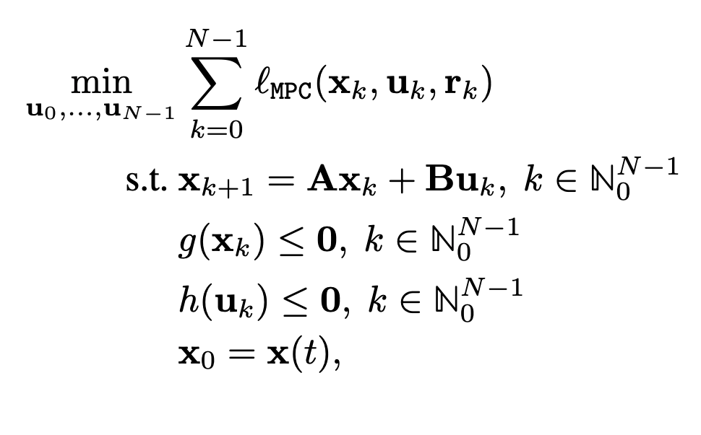
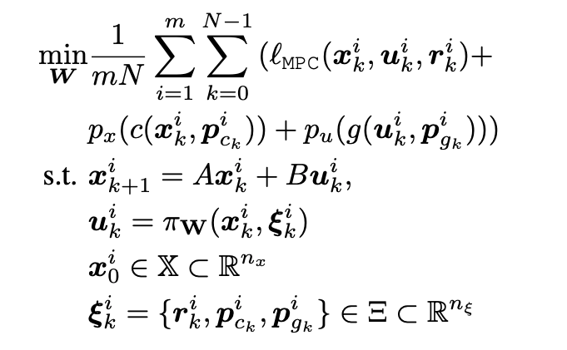
Differentiable Predictive Control
From data to optimized explicit predictive control policy
Model Predictive Control (MPC)
Differentiable Predictive Control (DPC)
Cost:
Model:
Constraints:
Online optimization
Optimize for control actions
Implicit solver-based control policy
Offline optimization of parametric MPC
Optimize for control policy parameters
Explicit neural control policy = faster execution!
Jan Drgona, et al., Differentiable Predictive Control: An MPC Alternative for Unknown Nonlinear Systems using Constrained Deep Learning, Journal of Process Control, 2022

Slide 7
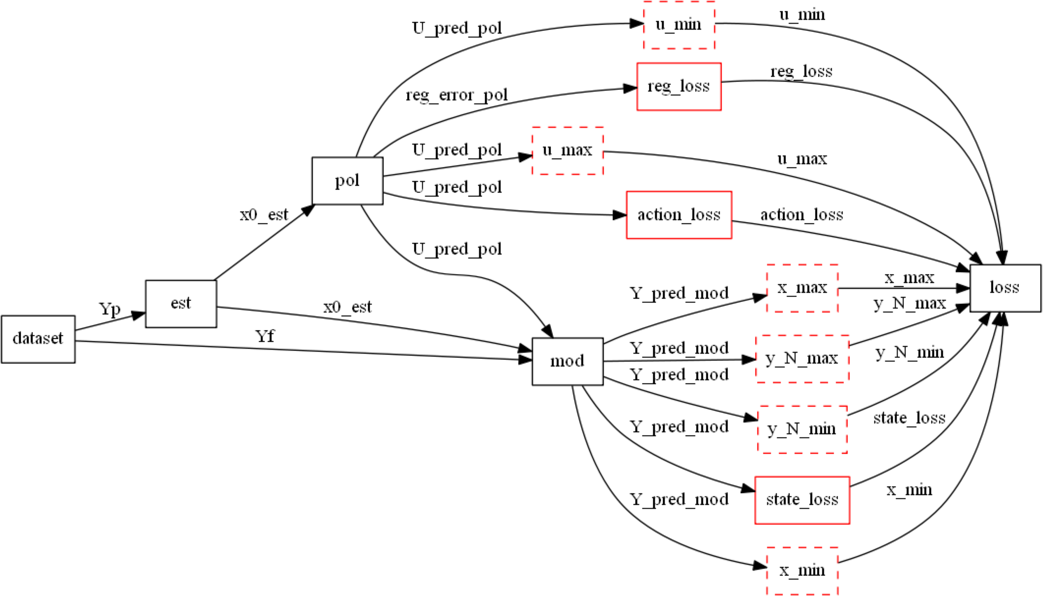
Differentiable Computational Graphs and Model-based Policy Gradients
Constructing differentiable computational graph: implementing parametric MPC problem in PyTorch.
https://github.com/pnnl/neuromancer

Slide 8
Differentiable Computational Graphs and Model-based Policy Gradients
Forward pass: evaluate graph components (policy, model, constraints, objective terms) to compute structured learning loss function.
https://github.com/pnnl/neuromancer

Slide 9
Differentiable Computational Graphs and Model-based Policy Gradients
Forward pass: evaluate graph components (policy, model, constraints, objective terms) to compute structured learning loss function.
https://github.com/pnnl/neuromancer

Slide 10
Differentiable Computational Graphs and Model-based Policy Gradients
Forward pass: evaluate graph components (policy, model, constraints, objective terms) to compute structured learning loss function.
https://github.com/pnnl/neuromancer

Slide 11
Differentiable Computational Graphs and Model-based Policy Gradients
Forward pass: evaluate graph components (policy, model, constraints, objective terms) to compute structured learning loss function.
https://github.com/pnnl/neuromancer

Slide 12
Differentiable Computational Graphs and Model-based Policy Gradients
Forward pass: evaluate graph components (policy, model, constraints, objective terms) to compute structured learning loss function.
https://github.com/pnnl/neuromancer

Slide 13
Differentiable Computational Graphs and Model-based Policy Gradients
Forward pass: evaluate graph components (policy, model, constraints, objective terms) to compute structured learning loss function.
https://github.com/pnnl/neuromancer

Slide 14
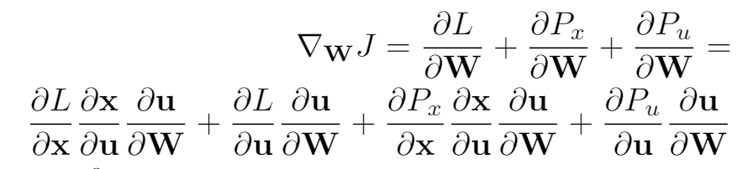
Differentiable Computational Graphs and Model-based Policy Gradients
Backward pass: Differentiate the computational graph to train the policies using automatic differentiation (AD) tools.
https://github.com/pnnl/neuromancer

Slide 15
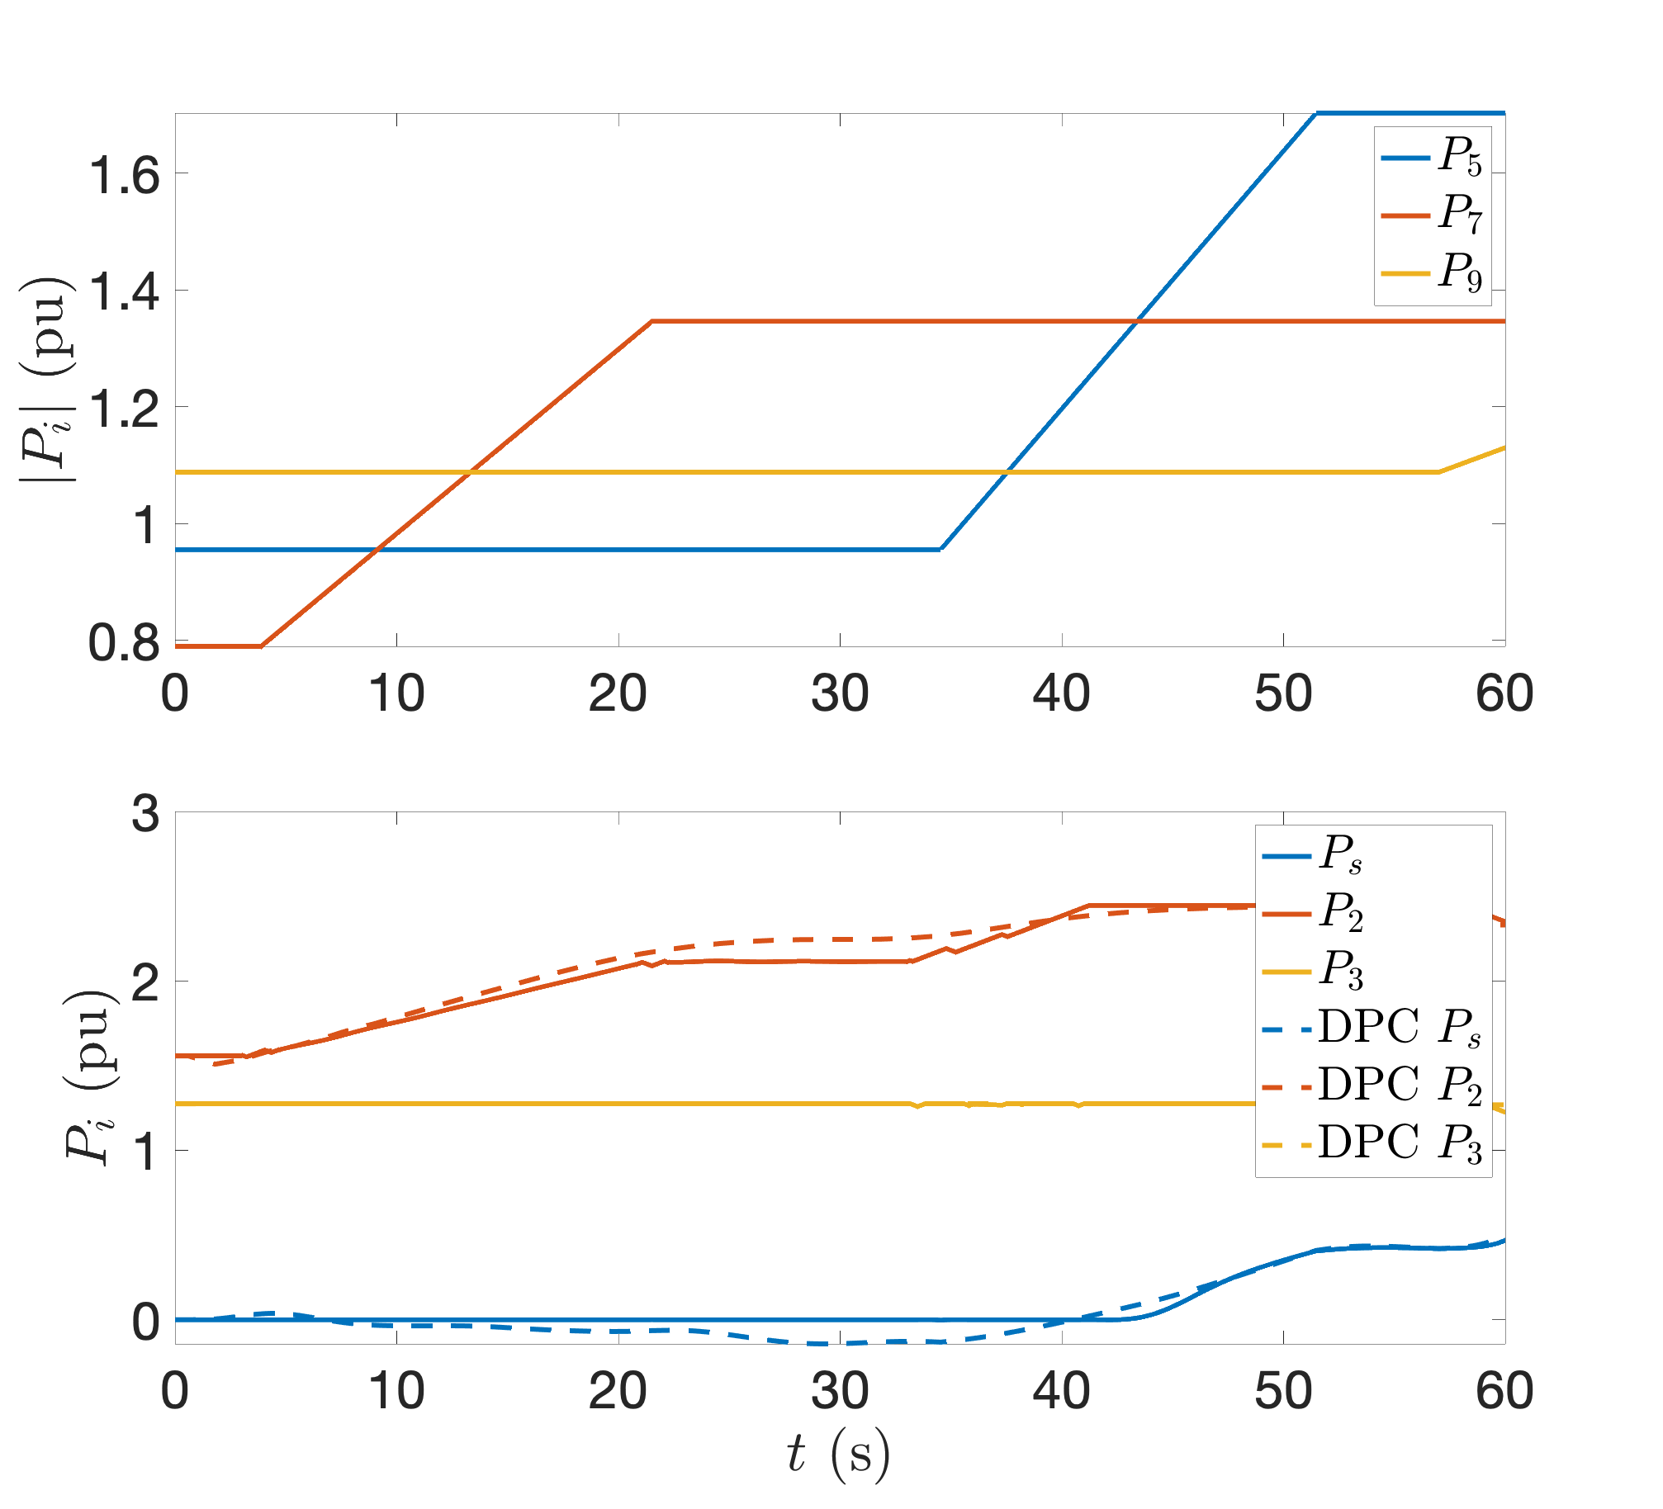
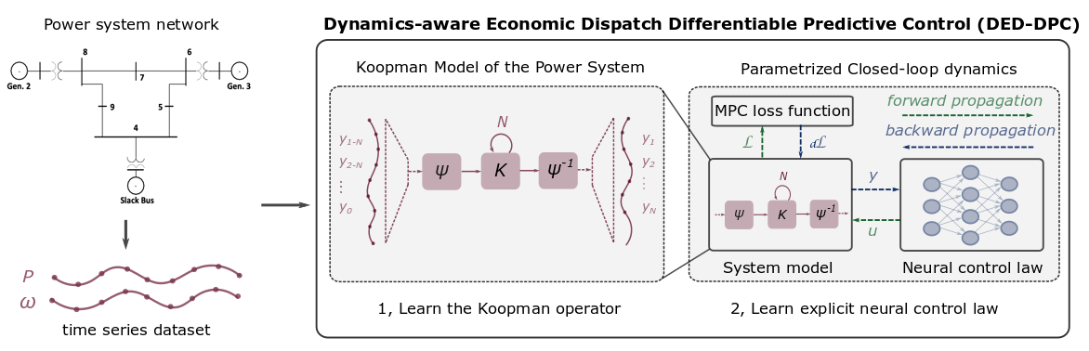
Dynamics-Aware Economic Redispatch via Differentiable Predictive Control
Problem: Current redispatch processes do not incorporate system dynamics concerns. Incorporating dynamics in redispatch is too complex and/or time-consuming
Architectures
Koopman dynamics model
CNN control policy
Solution: Machine-learning based dynamics-aware redispatch. Learn system dynamics for faster assessment.
Results
5 orders of magnitude speed-up
Near optimal performance
Ethan King, Ján Drgoňa, Aaron Tuor, Shrirang Abhyankar, Craig Bakker, Arnab Bhattacharya, Draguna Vrabie, Koopman-based Differentiable Predictive Control for the Dynamics-Aware Economic Dispatch Problem, 2022 American Control Conference

Slide 16
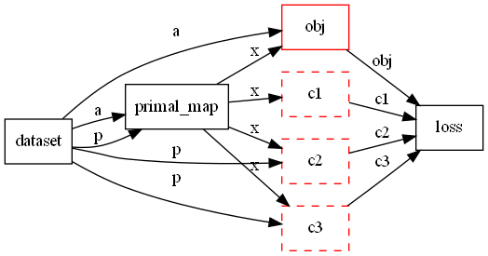
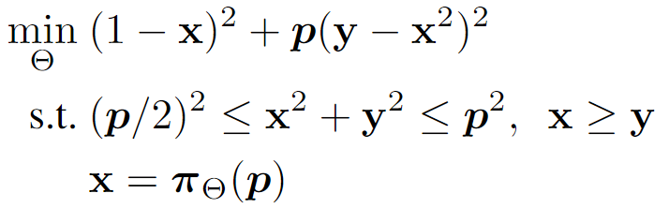
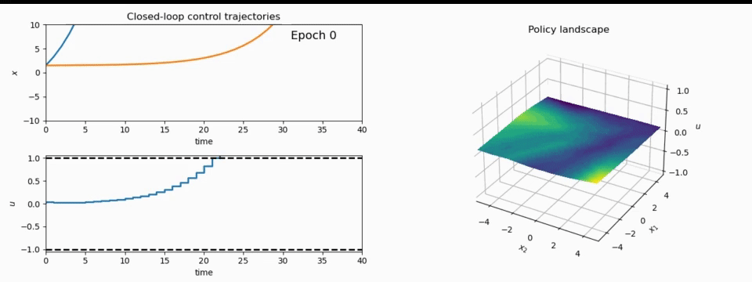
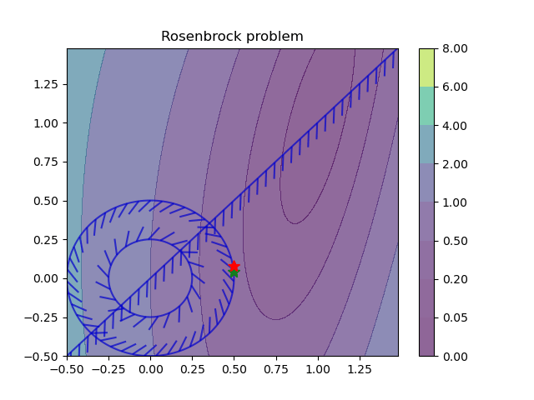
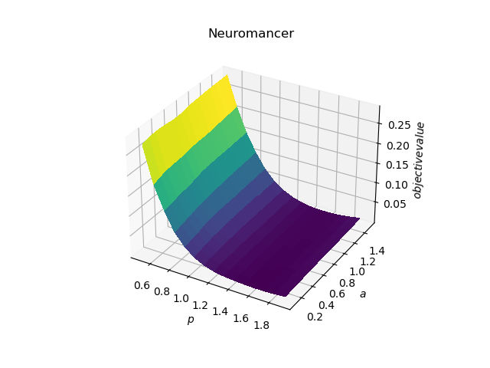
NeuroMANCER: a Scientific Machine Learning Library in PyTorch
1. Mathematical formulation
3. Problem graph
map
2. Python code interface
4. Results
import neuromancer as nm
p = nm.constraints.variable(‘p’)
x = nm.constraints.variable(‘x’)
y = nm.constraints.variable('y’)
obj = ((1-x)**2 + p*(y-x**2)**2).minimize(weight=1.0, name='obj’) c1 = (p/2)**2 <= x**2 + y**2
c2 = x**2 + y**2 <= p**2
c3 = x >= y net = nm.blocks.MLP(insize=2, outsize=2, hsizes=[80]*4) map = nm.maps.Map(net, input_keys=['p’], output_keys=[‘x’,‘y’])
loss = nm.loss.PenaltyLoss([obj], [c1, c2, c3]) problem = nm.problem.Problem([map], loss)
optimizer = torch.optim.AdamW(problem.parameters()) trainer = nm.Trainer(problem,data,optimizer)
best_model = trainer.train()

Slide 17



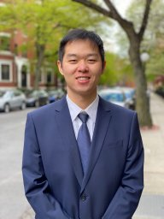





Acknowledgements
Email: jan.drgona@pnnl.gov
LinkedIn: https://www.linkedin.com/in/drgona/
Repository: https://github.com/pnnl/neuromancer
Youtube: https://www.youtube.com/@neuromancer_SciML
Aaron Tuor
James Koch
Zhao Chen
Ethan King
Shrirang Abhyankar
Draguna Vrabie

